Slide 1
Pediatric Vaccinations
By: Teresa Hunt
University of Central Florida

Slide 2


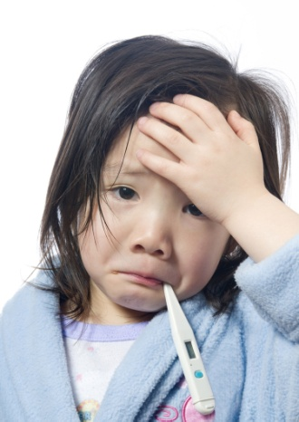
Barriers to Vaccination
Personal Beliefs
Health Concerns
Economic Status
High Risk Populations

Slide 3
Personal Beliefs and Health Concerns
Many parents are claiming religious beliefs, that would exclude them from having their child vaccinated. Current religions that do not allow vaccinations are Christian Scientology and certain fundamentalist.
Many fear that the injection will cause illness or neurological issues later in life. This started when Mercury was used in vaccinations that caused unwanted side effects (Fisher, 2007).”
“The minimal benefits of vaccination of society DO NOT outweigh the many risks for each individual, and that the greatest “benefit” of vaccination programs seems to be the multi-billion dollars of profit earned each year by the pharmaceutical companies as a result of mandatory vaccination programs (Cage, 2010).

Slide 4
Economic Status and High Risk Population
For those that are uninsured feel that the vaccinations are too expensive and DON’T really make any difference in their kids lives.
Individuals traveling oversees and children that frequent medical facilities.
School age children that are constant contact with other children

Slide 5
Fisher, B. (2007). Parents claim religion to avoid vaccines for kids. MSNBC.com: Children’s Health. Retrieved from http://www.msnbc.msn.com/id/21347434/ns/health-childrens_health/t/parents-claim-religion-avoid-vaccines-kids/#.Tn9iD9S8GuI
Cage, A. (2010). Health care in harmony with nature. South Bay Total Health. Retrieved from
http://www.southbaytotalhealth.com/Vaccinations.htm

